Slide 1


Polymorphism
Fundamental Computer Programming C++
C1002-A
Dr. Ihsan Ullah
ihsan@saturn.yzu.edu.tw
Office: 60913

Slide 2
Please mark your attendance by rollcall

Slide 3
Polymorphism in C++
What is Polymorphism?
Types of Polymorphism in C++
Compile-Time Polymorphism
Function Overloading
Operator Overloading
Runtime Polymorphism
Virtual Functions
Benefits of Polymorphism

Slide 4
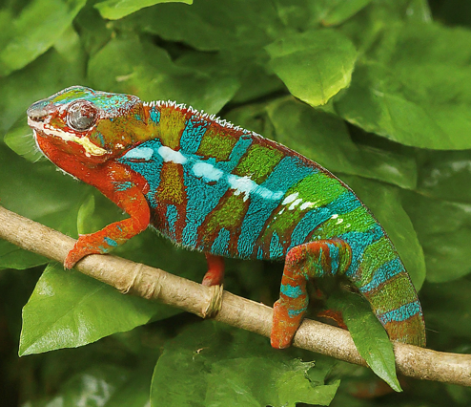
Polymorphism in C++
Polymorphism (Greek: "many forms") enables objects of different classes to respond to the same method call in distinct ways.
It's akin to a chameleon, which can change its color to blend into its environment. Similarly, polymorphic functions adapt their behavior based on the object they're invoked upon.

Slide 5
Introduction to Polymorphism
Polymorphism refers to the ability of a function to behave differently based on the object it is operating on.
It's a key concept in Object-Oriented Programming (OOP).

Slide 6
Benefits:
Code Reusability: Polymorphism allows developers to reuse code by enabling the same function to operate on different types of objects.
Flexibility: It provides flexibility in design and implementation, allowing for dynamic behavior based on the context.
Extensibility: Polymorphism facilitates the addition of new functionality without modifying existing code, promoting modular and scalable development practices.

Slide 7
Types of Polymorphism in C++
C++ supports two primary forms of polymorphism:
Compile-Time Polymorphism (Static Binding): Determined at compile time based on function signatures.
Runtime Polymorphism (Dynamic Binding):
Determined at runtime based on the object's type

Slide 8
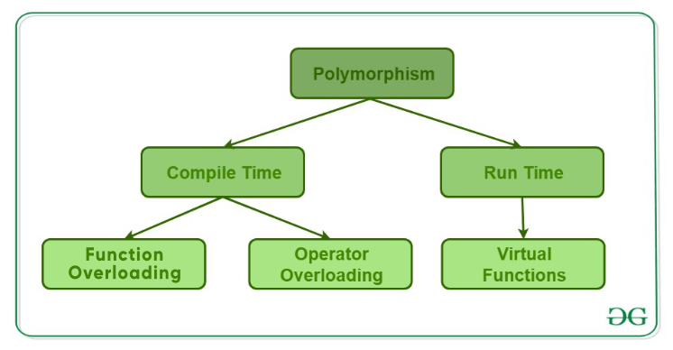
Types of Polymorphism
Compile-time polymorphism (Static Binding):
Function overloading
Operator overloading
Runtime polymorphism (Dynamic Binding):
Function overriding (virtual functions)

Slide 9
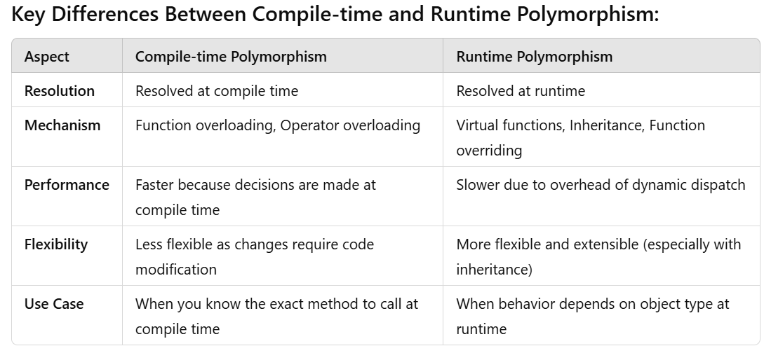
Types of Polymorphism

Slide 10
Function Overloading
Function overloading allows creating multiple functions with the same name but different parameters.
#include <iostream>
using namespace std;
class Printer {
public:
// Overloaded function to print an integer
void print(int i) {
cout << "Integer: " << i << endl;
}
// Overloaded function to print a string
void print(string s) {
cout << "String: " << s << endl;
}
};
int main() {
Printer printer;
printer.print(42); // Output: Integer: 42
printer.print("Hello"); // Output: String: Hello
return 0;
}

Slide 11
Compile-Time Polymorphism: Operator Overloading
Operator overloading extends operators like +, -, *, =, and others to work with custom classes.
This enables C++ code to interact with custom data types using familiar operators, enhancing code expressiveness and clarity.
#include <iostream>
using namespace std;
class Complex {
public:
int real, imag;
// Constructor
Complex(int r, int i) : real(r), imag(i) {}
// Overload '+' operator
Complex operator + (Complex const& obj) {
return Complex(real + obj.real, imag + obj.imag);
}
// Display function
void display() {
cout << real << " + " << imag << "i" << endl;
}
};
int main() {
Complex num1(3, 4), num2(1, 2);
Complex result = num1 + num2; // Using overloaded '+' operator
result.display(); // Output: 4 + 6i
return 0;
}

Slide 12
Runtime Polymorphism:
Virtual functions are member functions declared with the virtual keyword in the base class.
Inheritance allows a class to inherit the properties and behaviors (methods) of another class.
Function Overriding occurs when a derived class provides its own implementation of a function that is already defined in the base class.

Slide 13
Virtual Functions
Virtual functions are member functions declared with the virtual keyword in the base class.
#include <iostream>
using namespace std;
class Animal {
public:
virtual void speak() {
cout << "Animal speaks!" << endl; }
};
class Dog : public Animal { // Derived class
public:
void speak() override {
cout << "Dog barks!" << endl; }};
class Cat : public Animal { // Another derived class
public:
void speak() override {
cout << "Cat meows!" << endl; } };
int main() {
Animal* animalPtr;
Dog dog;
Cat cat;
animalPtr = &dog; // Using runtime polymorphism
animalPtr->speak(); // Output: Dog barks!
animalPtr = &cat;
animalPtr->speak(); // Output: Cat meows!
return 0;
}

Slide 14
Inheritance
#include <iostream>
using namespace std;
// Base class
class Animal {
public:
void eat() {
cout << "This animal is eating." << endl;
}
};
// Derived class
class Dog : public Animal {
public:
void bark() {
cout << "Dog is barking!" << endl;
}
};
int main() {
Dog dog;
dog.eat(); // Calling the inherited method from Animal class
dog.bark(); // Calling the method from Dog class
return 0;
}
Inheritance allows a class to inherit the properties and behaviors (methods) of another class.

Slide 15
Function Overriding
#include <iostream>
using namespace std;
// Base class
class Animal {
public:
virtual void sound() { // Virtual function
cout << "Animal makes a sound!" << endl; } };
class Dog : public Animal { // Derived class
public:
// Overriding the base class function
void sound() override {
cout << "Dog barks!" << endl; }};
class Cat : public Animal { // Another derived class
public:
void sound() override { // Overriding the base class function
cout << "Cat meows!" << endl; }};
int main() {
Animal* animalPtr;
Dog dog;
Cat cat;
animalPtr = &dog;
animalPtr->sound(); // Output: Dog barks!
animalPtr = &cat;
animalPtr->sound(); // Output: Cat meows!
return 0;
}
Function Overriding occurs when a derived class provides its own implementation of a function that is already defined in the base class.

Slide 16
CPE Exam Problem
Problem Statement: Check if a given string is a palindrome. A palindrome is a string that reads the same forward and backward (ignoring spaces, punctuation, and case).
Input:A single string s.
Output:"YES" if the string is a palindrome, otherwise "NO".
Example:
"madam“
"racecar“
"level“
“A man a plan a canal Panama”

